Slide 1
消息传递神经网络预测结果的可解释性
设计
Yang weiwei
Notes:
封面

Slide 2
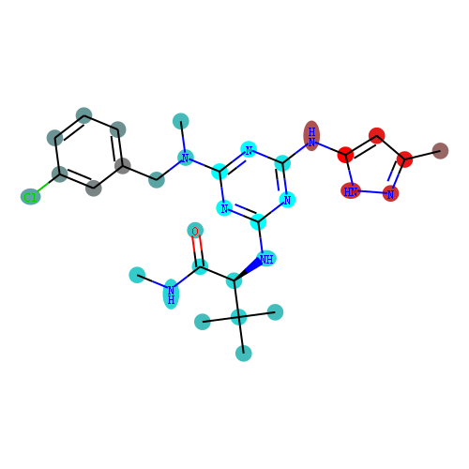
消息传递神经网络中获取分子结构可视化特征
消息传递神经网络中获取分子库分布的可视化特征
0
0.5
1

Slide 3
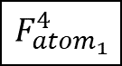
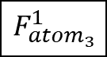
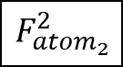
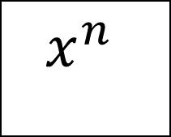
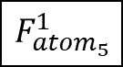

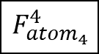

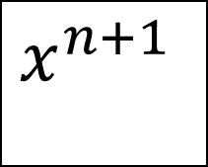
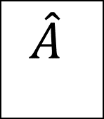
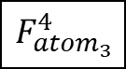
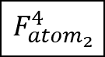
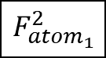




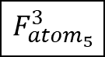
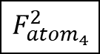
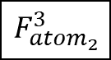

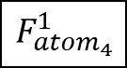

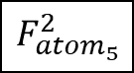
$$F_{{atom}_{1}}^{1}$$
$$\hat{A}$$
$$x^{n}$$
W
$$x^{n+1}$$
$$F_{{atom}_{1}}^{2}$$
$$F_{{atom}_{3}}^{1}$$
$$F_{{atom}_{5}}^{1}$$
$$F_{{atom}_{1}}^{3}$$
$$F_{{atom}_{3}}^{2}$$
$$F_{{atom}_{5}}^{2}$$
$$F_{{atom}_{1}}^{4}$$
1
$$F_{{atom}_{3}}^{3}$$
$$F_{{atom}_{5}}^{3}$$
$$F_{{atom}_{3}}^{4}$$
$$F_{{atom}_{5}}^{4}$$
3
5
$$F_{{atom}_{2}}^{1}$$
2
4
$$F_{{atom}_{2}}^{2}$$
$$F_{{atom}_{4}}^{1}$$
$$x^{n+1}$$
$$F_{{atom}_{2}}^{3}$$
$$F_{{atom}_{4}}^{2}$$
$$F_{{atom}_{2}}^{4}$$
$$F_{{atom}_{4}}^{3}$$
$$F_{{atom}_{4}}^{4}$$

Slide 4
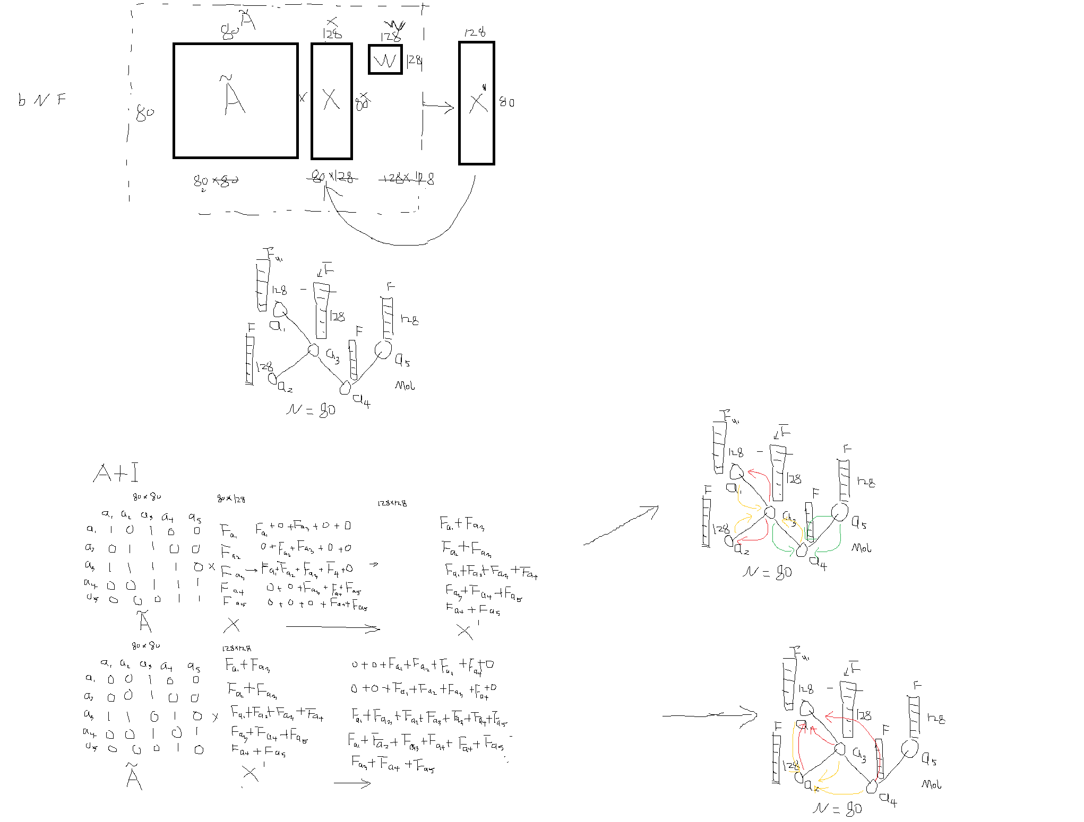
Test 387

Slide 5


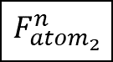

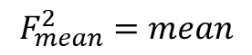
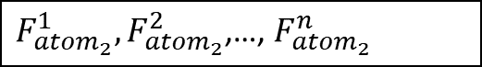



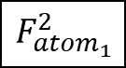
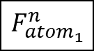
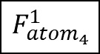
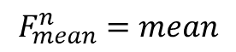

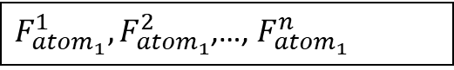
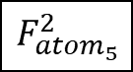
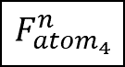

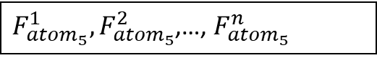
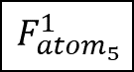



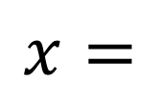
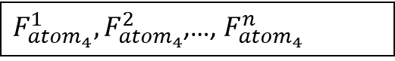







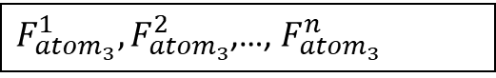



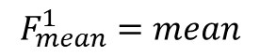


$F_{{atom}_{1}}^{1},F_{{atom}_{1}}^{2}$,…, $F_{{atom}_{1}}^{n}$
$$F_{{atom}_{2}}^{1},F_{{atom}_{2}}^{2}\text{,…, }F_{{atom}_{2}}^{n}$$
$$x=$$
$F_{{atom}_{3}}^{1},F_{{atom}_{3}}^{2}$,…, $F_{{atom}_{3}}^{n}$
$F_{{atom}_{4}}^{1},F_{{atom}_{4}}^{2}$,…, $F_{{atom}_{4}}^{n}$
$F_{{atom}_{5}}^{1},F_{{atom}_{5}}^{2}$,…, $F_{{atom}_{5}}^{n}$
1
3
5
$$F_{{atom}_{1}}^{1}$$
$$F_{{atom}_{1}}^{2}$$
$$F_{{atom}_{1}}^{n}$$
2
4
$$F_{{atom}_{2}}^{1}$$
$$F_{{atom}_{2}}^{2}$$
$$F_{{atom}_{2}}^{n}$$
$$F_{{atom}_{3}}^{1}$$
$$F_{{atom}_{3}}^{2}$$
…
$$F_{{atom}_{3}}^{n}$$
$$F_{{atom}_{4}}^{1}$$
$$F_{{atom}_{4}}^{2}$$
$$F_{{atom}_{4}}^{n}$$
$$F_{{atom}_{5}}^{1}$$
$$F_{{atom}_{5}}^{2}$$
$$F_{{atom}_{5}}^{n}$$
$$F_{{atom}_{1}}^{1}$$
$$F_{{atom}_{1}}^{1}$$
$$F_{{atom}_{1}}^{1}$$
$$F_{{atom}_{2}}^{1}$$
$$F_{{atom}_{2}}^{1}$$
$$F_{{atom}_{2}}^{1}$$
$$F_{mean}^{1}=mean$$
$$F_{{atom}_{3}}^{1}$$
$$F_{mean}^{2}=mean$$
$$F_{{atom}_{3}}^{1}$$
…
$$F_{mean}^{n}=mean$$
$$F_{{atom}_{3}}^{1}$$
$$F_{{atom}_{4}}^{1}$$
$$F_{{atom}_{4}}^{1}$$
$$F_{{atom}_{4}}^{1}$$
$$F_{{atom}_{5}}^{1}$$
$$F_{{atom}_{5}}^{1}$$
$$F_{{atom}_{5}}^{1}$$

Slide 6
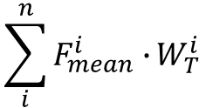
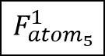




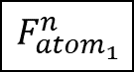
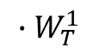
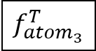
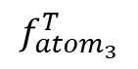
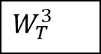
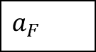

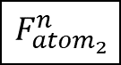



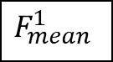
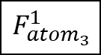
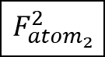
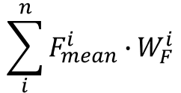
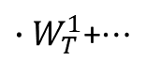
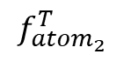
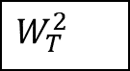
































$$\sum_{i}^{n}{F_{mean}^{i}∙}W_{T}^{i}$$
$$W_{T}^{1}$$
$$W_{F}^{1}$$
.
$$W_{T}^{2}$$
$$W_{F}^{2}$$
$$a_{T}$$
$$F_{mean}^{1}$$
$$F_{mean}^{2}$$
…
$$F_{mean}^{n}$$
…
…
$$a_{F}$$
$$\sum_{i}^{n}{F_{mean}^{i}∙}W_{F}^{i}$$
$$W_{T}^{3}$$
$$W_{F}^{3}$$
…
$$F_{{atom}_{1}}^{1}$$
$$F_{{atom}_{1}}^{2}$$
$$F_{{atom}_{1}}^{n}$$
$$F_{{atom}_{1}}^{1}$$
$$F_{{atom}_{1}}^{2}$$
$$F_{{atom}_{1}}^{n}$$
$$f_{{atom}_{1}}^{T}$$
$$F_{{atom}_{2}}^{1}$$
$$F_{{atom}_{2}}^{2}$$
$$F_{{atom}_{2}}^{n}$$
$$F_{{atom}_{2}}^{1}$$
$$F_{{atom}_{2}}^{2}$$
$$F_{{atom}_{2}}^{n}$$
$$f_{{atom}_{2}}^{T}$$
$$F_{{atom}_{3}}^{1}$$
$$F_{{atom}_{3}}^{2}$$
…
$$F_{{atom}_{3}}^{n}$$
$$F_{{atom}_{3}}^{1}$$
${∙W}_{T}^{1}$+
$$F_{{atom}_{3}}^{2}$$
${∙W}_{T}^{1}$+$⋯$
$$F_{{atom}_{3}}^{n}$$
$${∙W}_{T}^{1}$$
$$f_{{atom}_{3}}^{T}$$
$$F_{{atom}_{4}}^{1}$$
$$F_{{atom}_{4}}^{2}$$
$$F_{{atom}_{4}}^{n}$$
$$F_{{atom}_{4}}^{1}$$
$$F_{{atom}_{4}}^{2}$$
$$F_{{atom}_{4}}^{n}$$
$$f_{{atom}_{4}}^{T}$$
$$F_{{atom}_{5}}^{1}$$
$$F_{{atom}_{5}}^{2}$$
$$F_{{atom}_{5}}^{n}$$
$$F_{{atom}_{5}}^{1}$$
$$F_{{atom}_{5}}^{2}$$
$$F_{{atom}_{5}}^{n}$$
$$f_{{atom}_{5}}^{T}$$
$$f_{{atom}_{1}}^{T}$$
1
$$f_{{atom}_{3}}^{T}$$
$$f_{{atom}_{5}}^{T}$$
3
5
$$f_{{atom}_{2}}^{T}$$
2
4
$$f_{{atom}_{4}}^{T}$$

Slide 7





















































$$F_{{atom}_{1}}^{1}$$
$$F_{{atom}_{1}}^{2}$$
$$F_{{atom}_{1}}^{n}$$
$$F_{{atom}_{1}}^{1}$$
$$F_{{atom}_{1}}^{2}$$
$$F_{{atom}_{1}}^{n}$$
$$f_{{atom}_{1}}^{F}$$
$$F_{{atom}_{2}}^{1}$$
$$F_{{atom}_{2}}^{2}$$
$$F_{{atom}_{2}}^{n}$$
$$F_{{atom}_{2}}^{1}$$
$$F_{{atom}_{2}}^{2}$$
$$F_{{atom}_{2}}^{n}$$
$$f_{{atom}_{2}}^{F}$$
$$F_{{atom}_{3}}^{1}$$
$$F_{{atom}_{3}}^{2}$$
…
$$F_{{atom}_{3}}^{n}$$
$$F_{{atom}_{3}}^{1}$$
${∙W}_{F}^{1}$+
$$F_{{atom}_{3}}^{2}$$
${∙W}_{F}^{1}$+$⋯$
$$F_{{atom}_{3}}^{n}$$
$${∙W}_{F}^{1}$$
$$f_{{atom}_{3}}^{F}$$
$$F_{{atom}_{4}}^{1}$$
$$F_{{atom}_{4}}^{2}$$
$$F_{{atom}_{4}}^{n}$$
$$F_{{atom}_{4}}^{1}$$
$$F_{{atom}_{4}}^{2}$$
$$F_{{atom}_{4}}^{n}$$
$$f_{{atom}_{4}}^{F}$$
$$F_{{atom}_{5}}^{1}$$
$$F_{{atom}_{5}}^{2}$$
$$F_{{atom}_{5}}^{n}$$
$$F_{{atom}_{5}}^{1}$$
$$F_{{atom}_{5}}^{2}$$
$$F_{{atom}_{5}}^{n}$$
$$f_{{atom}_{5}}^{F}$$
$$f_{{atom}_{1}}^{T}$$
$$f_{{atom}_{1}}^{F}$$
$$f_{{atom}_{1}}^{}$$
1
$$f_{{atom}_{3}}^{T}$$
1
$$f_{{atom}_{3}}^{F}$$
$$f_{{atom}_{5}}^{T}$$
1
$$f_{{atom}_{3}}^{}$$
$$f_{{atom}_{5}}^{F}$$
$$f_{{atom}_{5}}^{}$$
3
5
3
5
3
5
2
4
$$f_{{atom}_{4}}^{T}$$
2
4
$$f_{{atom}_{4}}^{F}$$
2
4
$$f_{{atom}_{4}}^{}$$
$$f_{{atom}_{2}}^{T}$$
$$f_{{atom}_{2}}^{F}$$
$$f_{{atom}_{2}}^{}$$

Slide 8
0
0.5
1
天蓝色：认为该原子对分子被判定为活性分子有消极贡献
亮红色：认为该原子对分子被判定为活性分子有积极贡献

Slide 9
Training data 4000 Test data 387
Has binding strength information
Training data 40387
Test data 387
No binding strength information
Valid data 100
Valid data 100

Slide 10


Slide 11













$$y=−x+b$$
$$y=x$$
从图卷积神经网络中获取分子结构可视化特征
从预测结果获取数据分布特征
$$y=x+b$$

Slide 12













$$y=−x+b$$
$$y=x$$
从图卷积神经网络中获取分子结构可视化特征
$$y=x+b$$
从预测结果获取数据分布特征

Slide 13












Slide 14

0
0.5
1
天蓝色：认为该原子对分子被判定为活性分子有消极贡献
亮红色：认为该原子对分子被判定为活性分子有积极贡献

Slide 15
Thanks for your attention!
Faster Drug Discovery

